Slide 1
Venezuelan Economic Crisis(2014-Present)
By: Victor Cardeno

Slide 2
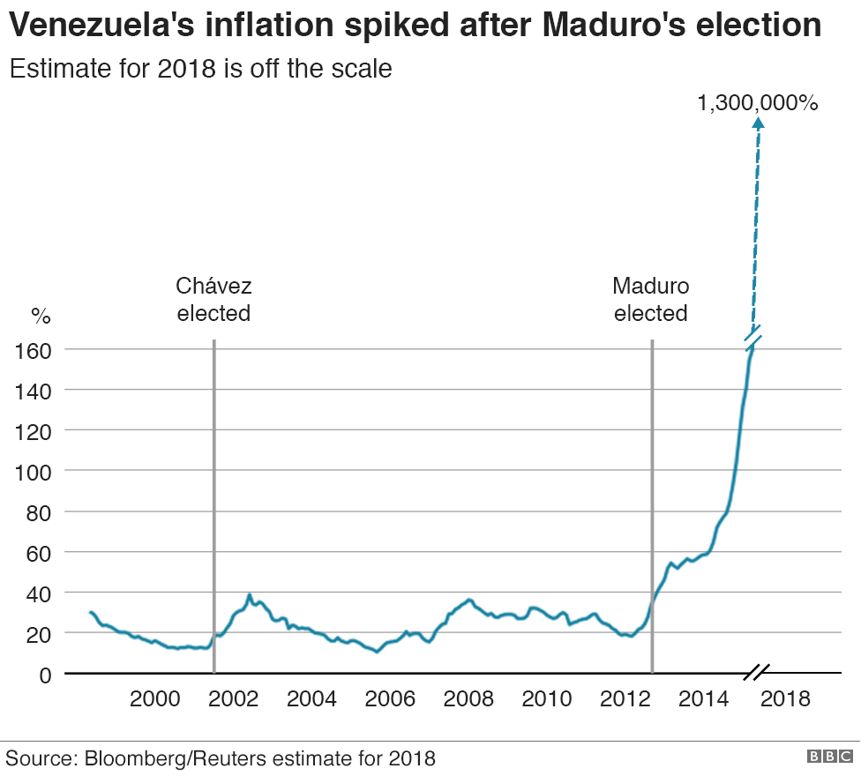
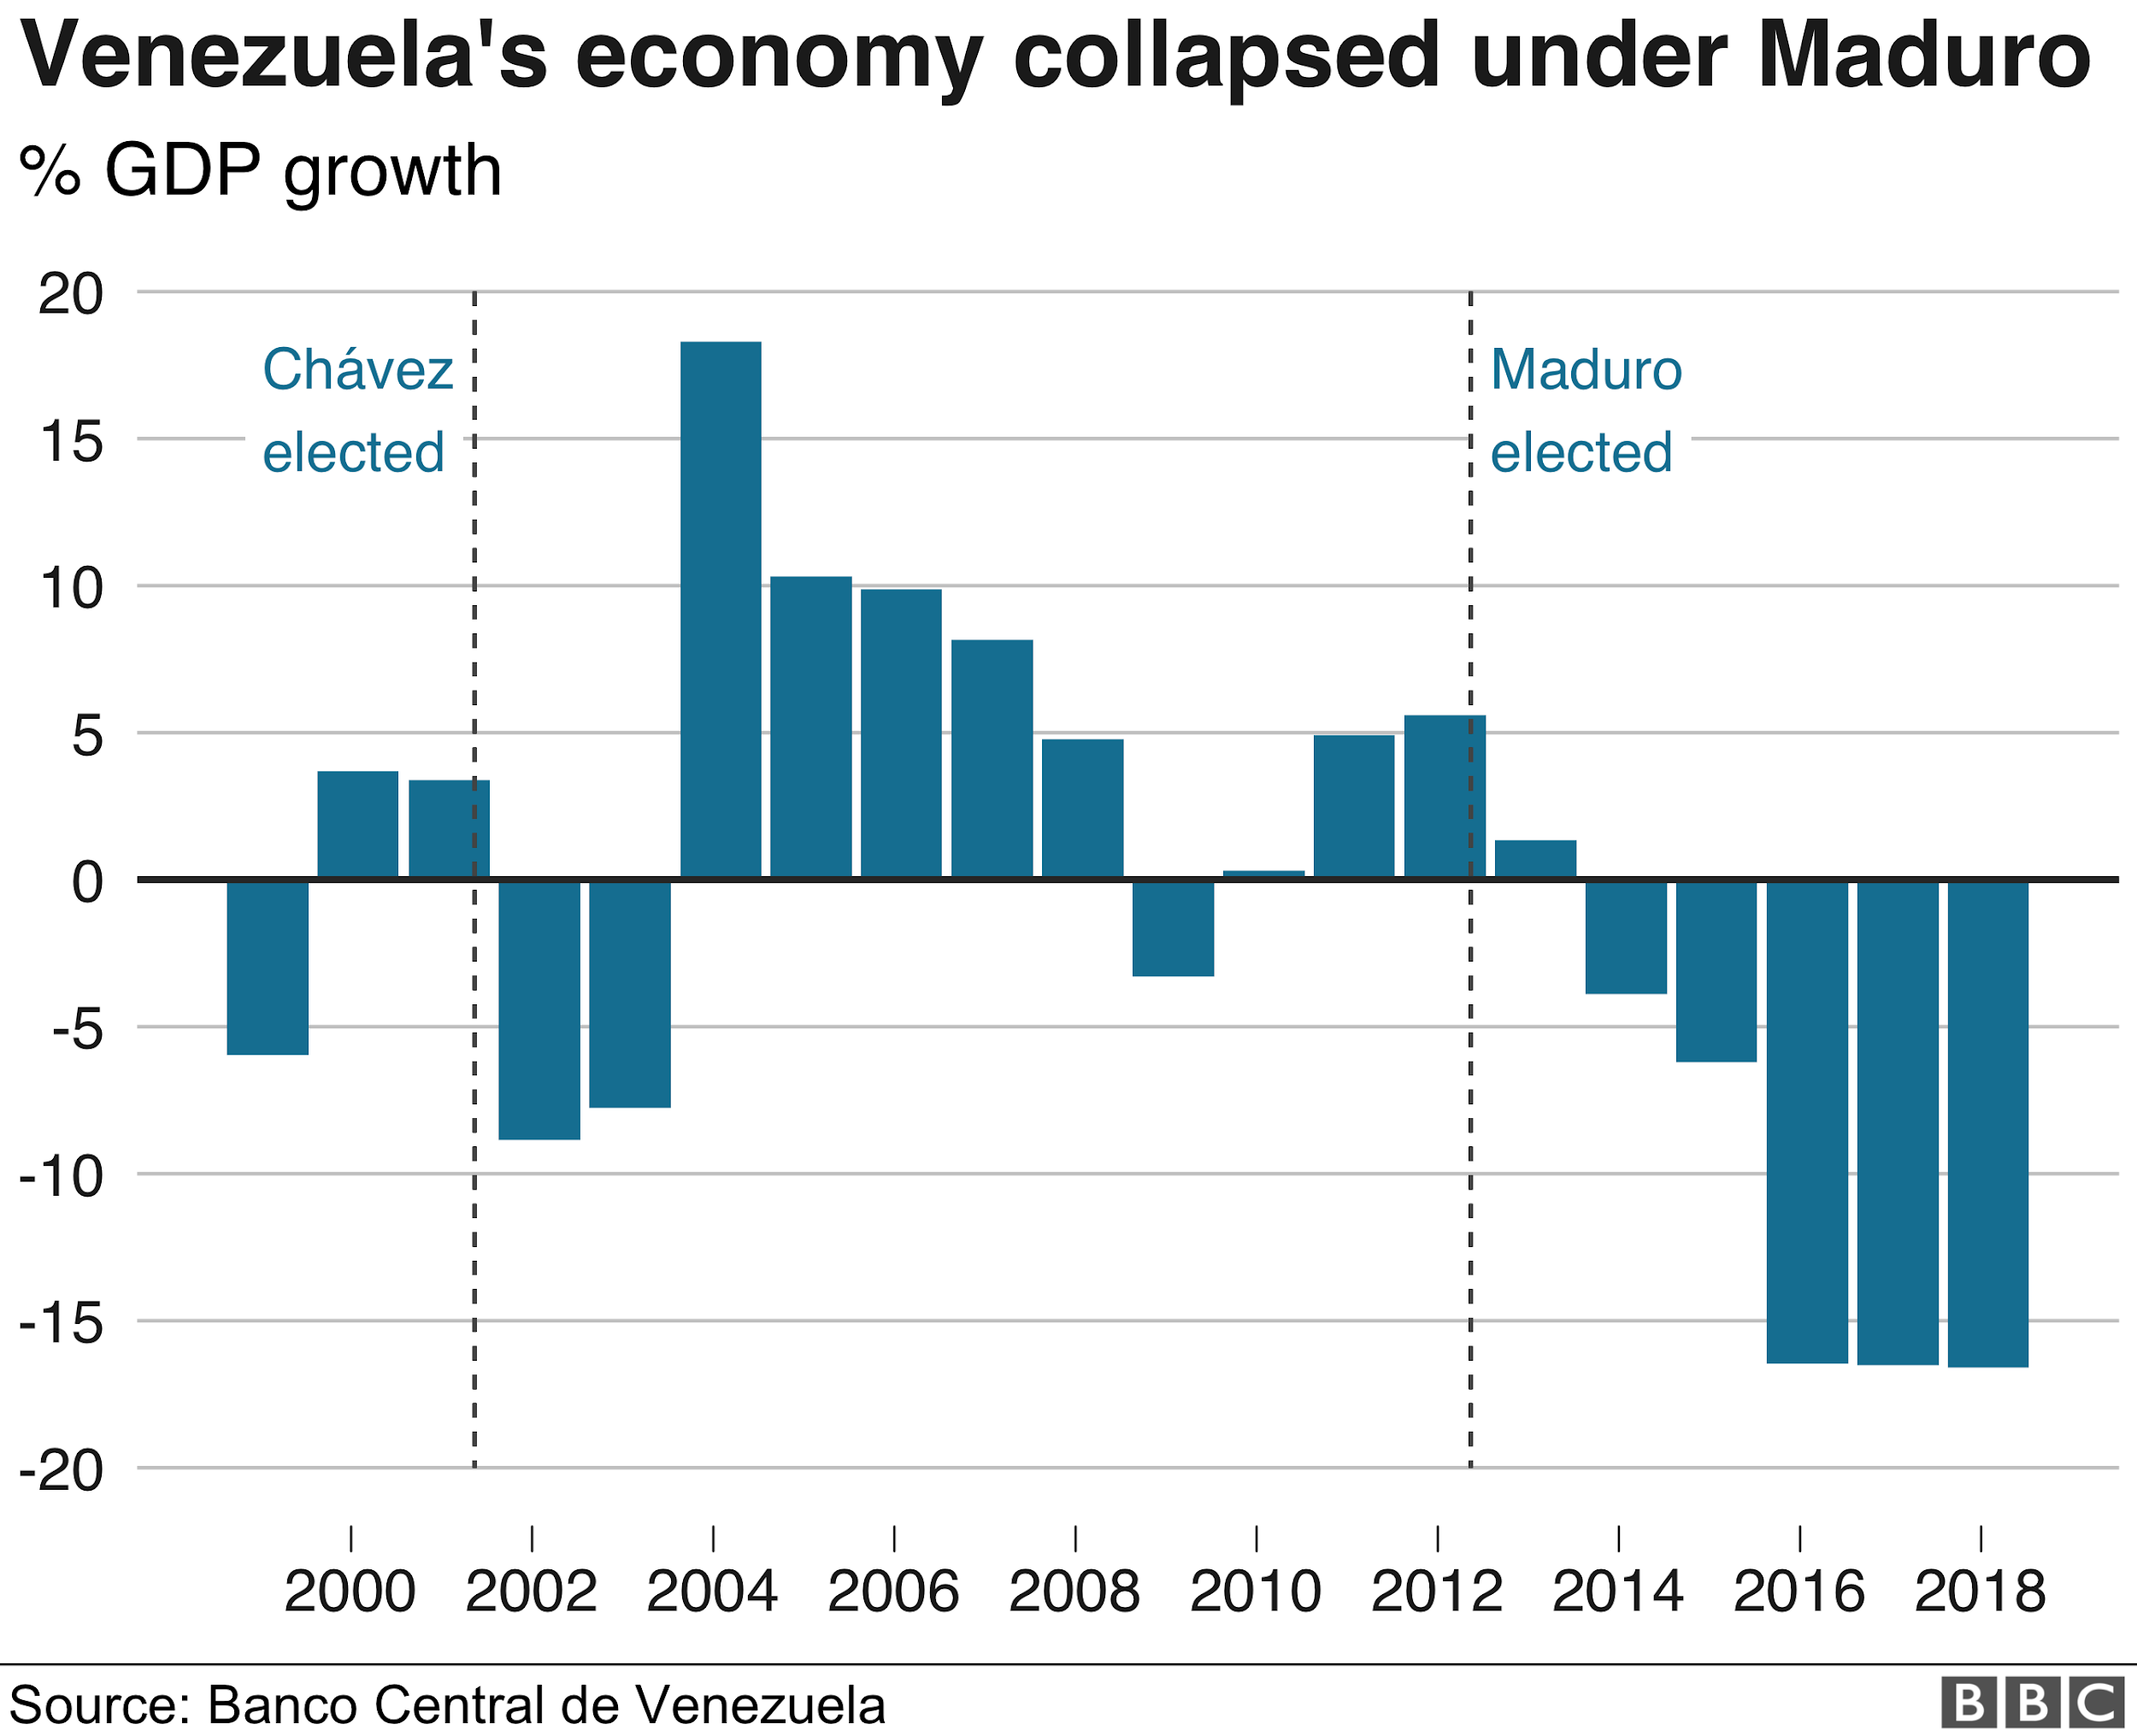
Crisis in Graphs

Slide 3
Thesis
Thesis: I will argue that the actions and policies of the Chavez regime weakened the economic infrastructure of Venezuela, leaving it vulnerable to the massive crisis caused by plummeting oil prices in 2014. I will also propose that the correct measures to reverse the descent of Venezuela begin with the deposition of Chavez’s successor, Nicolas Maduro, whose establishment has initiated irresponsible and inflationary strategies that have only worsened the situation in the country.
Part I: Oil Mismanagement & Lack of Diversification
Part II: Irresponsible and Unchecked Gov’t Spending
Part III: Harmful Economic Policy(Crisis Response)

Slide 4
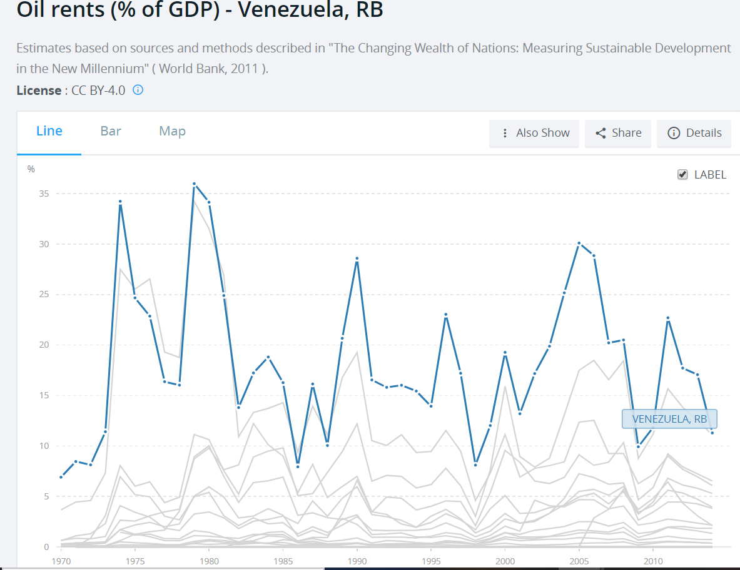
Importance of Oil
Venezuela discovered oil in 1914 and quickly began to utilize the valuable commodity to its advantage.
Oil rapidly rose to become Venezuela’s most valuable resource.

Slide 5
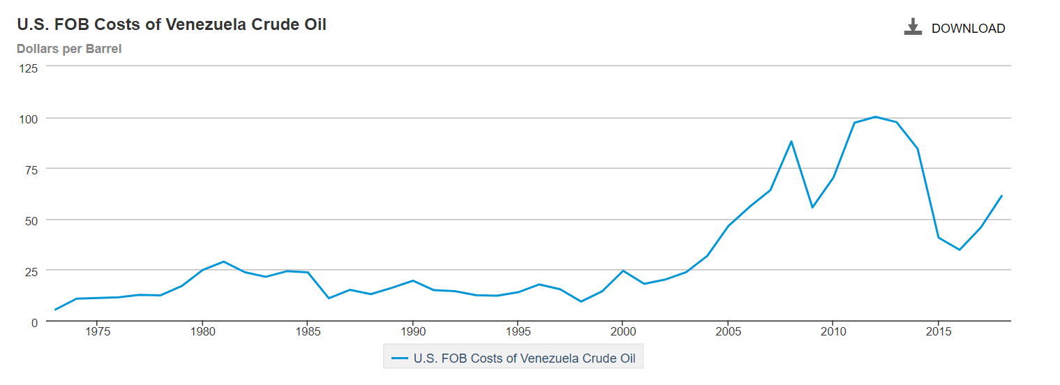
Oil Price Collapse
Today: Oil accounts for 25% of Venezuela’s GDP and 95% of its exports
Historically, when the oil price is high, Venezuela has prospered, but low oil prices have brought on periods of recession--->2014

Slide 6
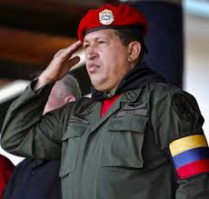
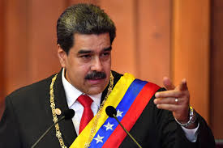
Political Players
Hugo Chavez (1998-2013)
Member of military sect that attempted to overthrow past regime for corruption
Elected in 1998 promising a populist government that would champion the people over the elites
Nicolas Maduro (2013-present): Chavez’s Vice President and chosen successor
Notes:
Talk about political consolidation practices

Slide 7
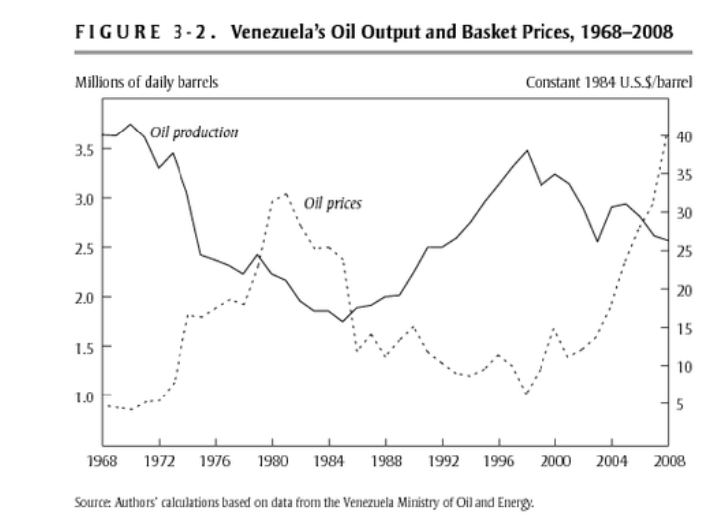
Part I: Oil Mismanagement & Lack of Diversification
Chavez’s first significant action: initiating adherence to OPEC petroleum policy
In previous years, Venezuela had agreed to limit production, but then ignored those limits in favor of maximizing revenue--->Chavez decided to abide by those restrictions--->led to decreased revenue stream from the industry
Began to offer concessions to foreign countries, especially Cuba

Slide 8
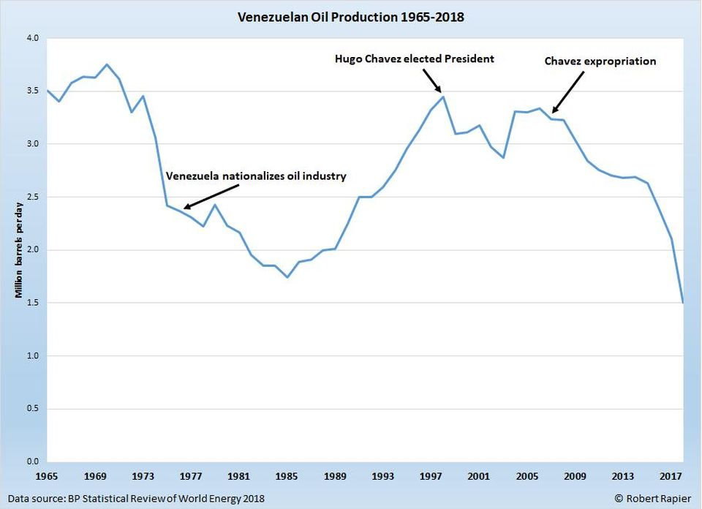
Conflict with PDVSA
PDVSA: largest Venezuelan state-owned oil company
2002: PDVSA managers wanted to defy OPEC policy, continue high production, and reinvest into further oil exploration
Chavez needed revenue to fund spending programs
Decision: Remove the board members of PDVSA and replace them with his own incompetent cronies
First example of Chavez removing valuable human capital in economic infrastructure--->led to loss of many competent individuals and industry experts

Slide 9
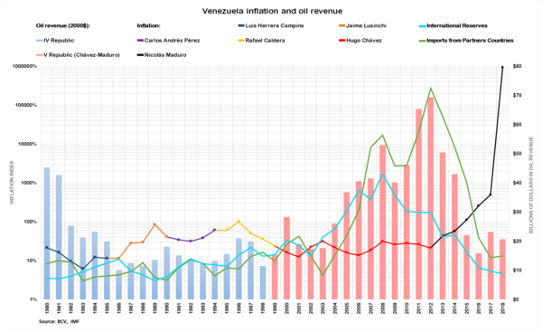
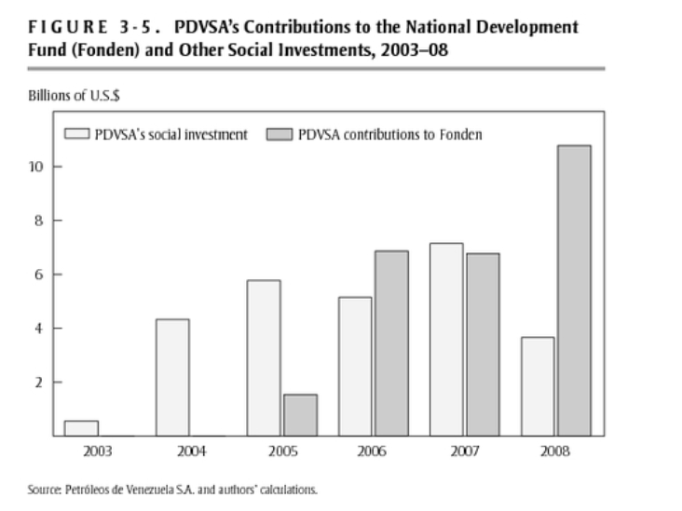
Misuse of Funds from Rising Oil Prices
As oil revenue increased due to rise in price, Chavez increased direct funding from oil companies to government.
These funds could have been reinvested to further improve oil production in the country.

Slide 10
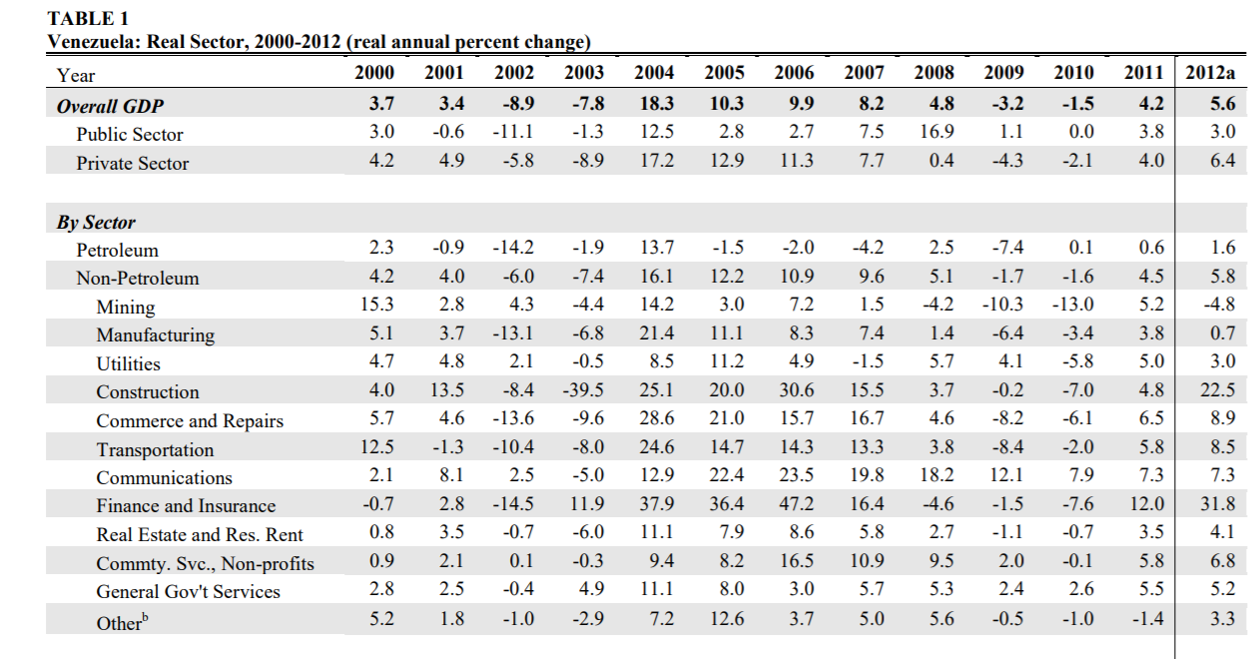
Lack of Economic Diversification
Chavez failed to utilize increased revenue during the boom to support economic diversification in other sectors and decrease reliance on oil.
Venezuela would have limited alternative income stream to fall back on when oil prices fell again.

Slide 11
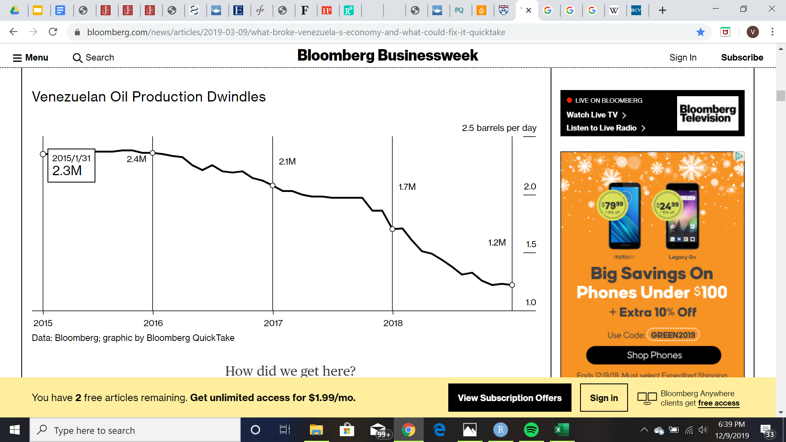
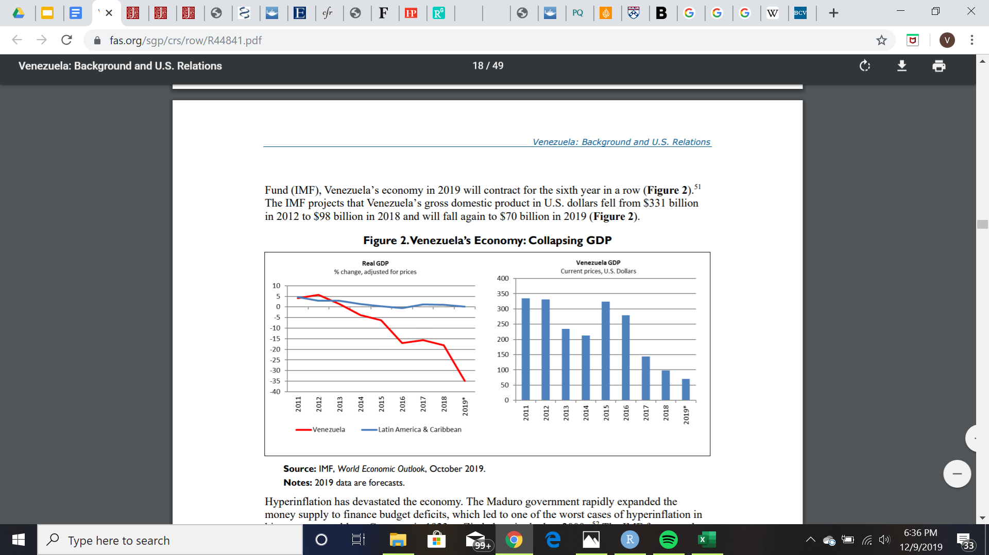
Connection to Maduro and Current Crisis
When oil prices fell in 2014, the flagging yield of the industry was exposed, and oil revenue dropped massively.
Oil production has fallen off in the past 4 years since the crisis began, and real GDP has tanked along with it.

Slide 12
Maduro’s Oil Policy
Maduro has prioritized payments on oil-related, and specifically PDVSA-related, debt in order to avoid seizure of Citgo and loss of access to American oil markets.
Continuing Chavez’s policy of borrowing from Russia and China against future oil exports

Slide 13
Benefits of New Regime
A more US-friendly administration may lead to removal of sanctions, leading to easier access to markets.
Primary opposition leader, Juan Guaidó, has declared selections for board positions at PDVSA--->allegedly include experienced industry individuals

Slide 14
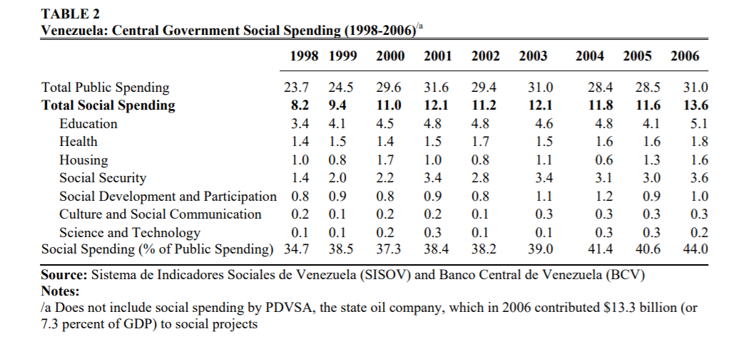
Part II: Irresponsible and Unchecked Gov’t Spending
Chavez was elected on a platform of populist ideals--->needed to spend to help raise the lower and middle class

Slide 15
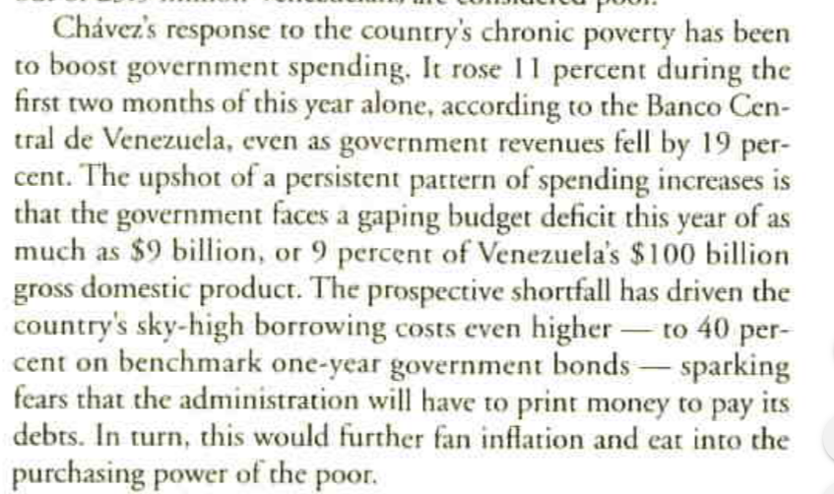
Spending in the Face of Uncertainty
However, the economy was still struggling over the first few years of Chavez’s presidency. Thus, he was spending on programs with little return on investment while his revenue stream dried up.
Article from Institutional Investor, July 2002

Slide 16
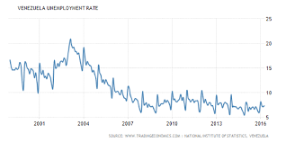
The Misiones
Chavez took advantage of the rising oil revenues and began a series of social spending programs called misiones in 2003 to improve adult literacy rates, subsidize food, etc.
By 2006, the share of public spending going to social programs was 44%.
This is an example of the Chavez administration spending money on programs with little return instead of investing in oil infrastructure or diversification of the economy.
Notes:
Within a few months of passing the legislation, the administration passed 4 percent of GDP into funding the misiones

Slide 17
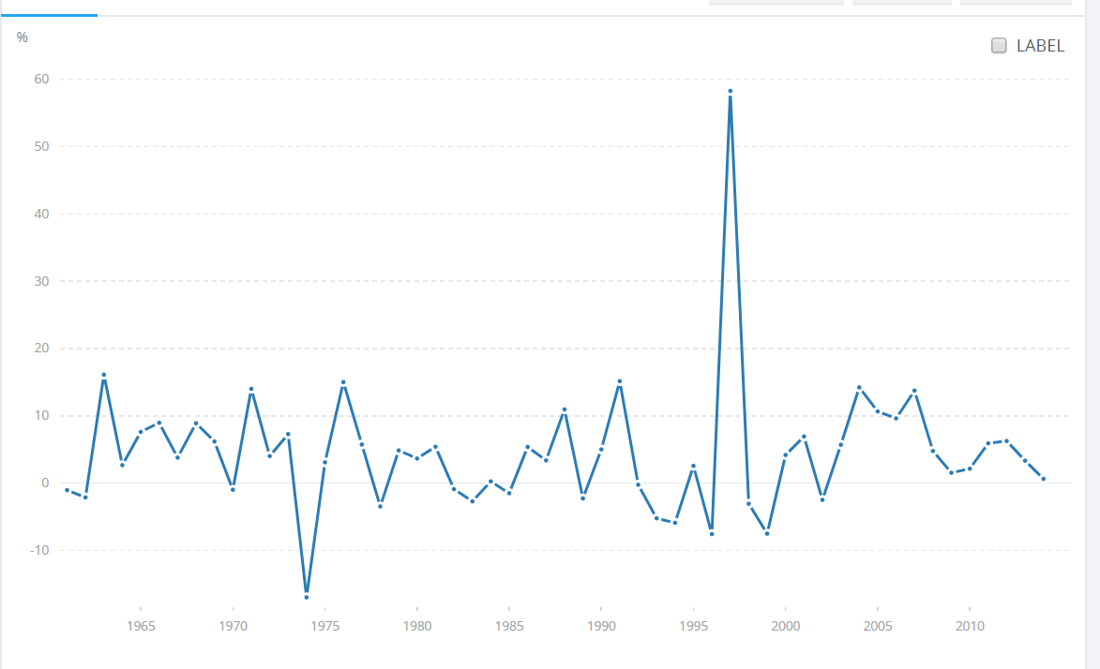
Spending in Time of Recession
Annual % Growth of Gov’t Expenditure
When a downturn in global markets occurred in the late 2000s, Venezuela’s economy once again took a hit.
Chavez administration decided against reducing spending in favor of tightening price and exchange rate controls.
World Bank data shows that public spending actually grew 3 percent on average from 2008 to 2011.
Venezuela ended up as one of the countries hit the hardest in the recession.
Chavez elected

Slide 18
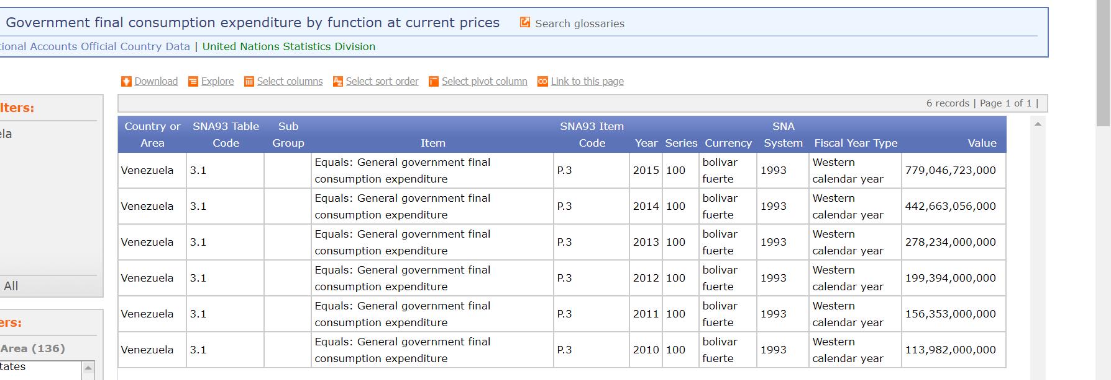
Connection to Current Crisis and Maduro Regime
Facing a more severe crisis in 2014, Maduro decided to follow Chavez’s example and avoid spending cuts in favor of printing money to cover its deficit.

Slide 19
Benefits of New Regime
Maduro has resisted accepting bailout packages from the IMF, but a new administration may be more willing to work with them.
Accepting austerity measures such as raising taxes and cutting government expenditure by reducing government salaries and social spending programs could help reduce the strain on the economy and put the country in a better position moving forward.

Slide 20
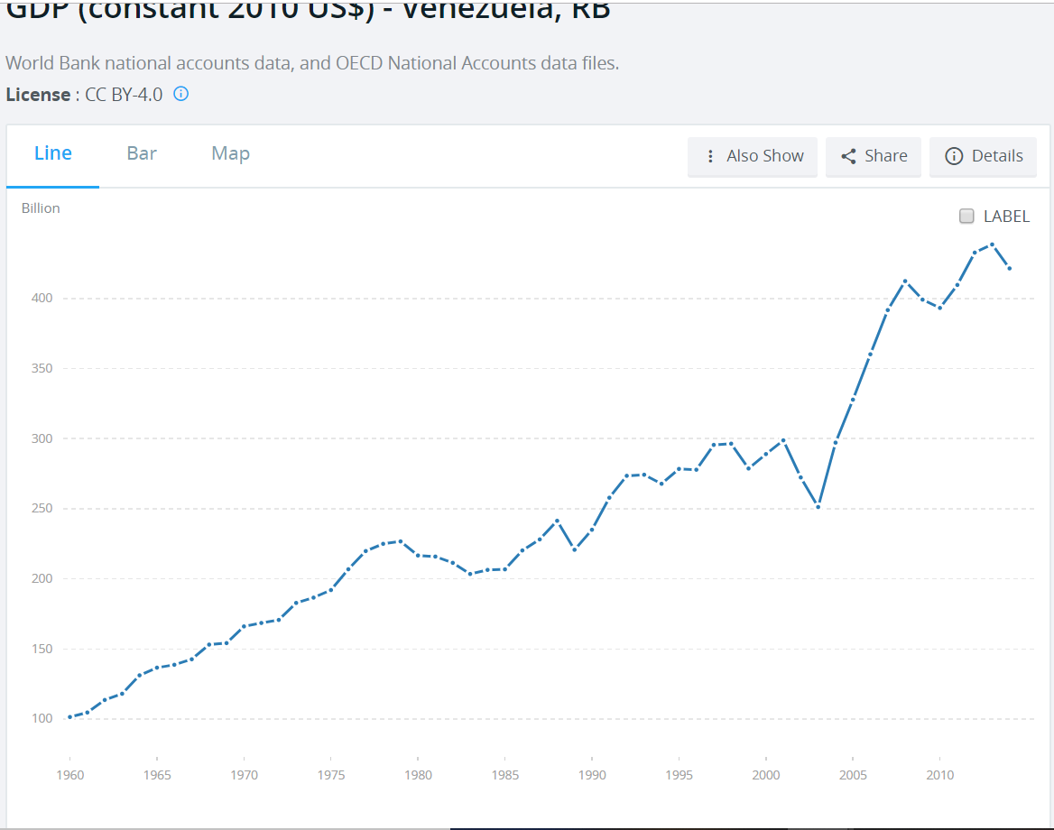
Part III: Harmful Economic Policy(Crisis Response)
The last section of my paper focuses on the harmful economic policy decisions the Chavez administration made, particularly in response to the two periods of recession during his reign in 2001-2003 and 2008-2011.

Slide 21
Initial Policies
In the first year or two of his tenure, Chavez continued the relatively conservative fiscal policies of his predecessor.
Low gov’t spending
Low taxes
Minimal debt
Friendly to foreign investment
However, he struggled to improve the economy, and capital flight was increasing due to the political turmoil in the region.

Slide 22
Dutch Disease & Response
Venezuela suffers from Dutch Disease: the exploitation of a valuable commodity leads to negative consequences for the rest of the economy
In Venezuela's case: the high value of oil leads to high demand for the bolivar as investors attempt to tap into the oil market--->raises value of bolivar and leads to a near-constant overvaluation over time
Historically, Venezuela had been on a crawling exchange rate for about a decade, but Chavez let the currency float in 2002.
Led to immediate devaluation of currency by about 30%, causing speculative attacks
Floating system collapsed when oil strike hit and exports tanked
Notes:
Talk about how some people warned against floating cause of rising inflation or more substantial devaluation needed
Talk about pressure from businesses and stuff due to the overvalued currency increasing imports and decreasing exports
The Dutch Disease arises out of primary-export dependence. For many countries, singleexport dependence erects a trade barrier through currency appreciation. When a country suddenly strikes oil, for example, it is faced with the opportunity to export a large supply of lucrative goods that can potentially provide much of the country’s revenue. The export windfall encourages the sale of the national currency to foreigners who are eager to convert it into the export good, therefore driving up its price via a shift right in the demand curve. The overvalued currency causes an immediate rise in prices of other exports on the world market, thus rendering them uncompetitive. The result is depressive for alternative export industries, whose goods become more expensive on the world market, suppressing production and forcing industries to close or to merely produce locally. Similarly, imports are made cheaper, and the same industries that were forced out of the world market are now competing with cheaper imports as well.26 The result, one that Venezuela suffers most from, is the lack of available, lucrative industries that are attractive to local investors. This creates the problem of capital flight, which I will discuss below.

Slide 23
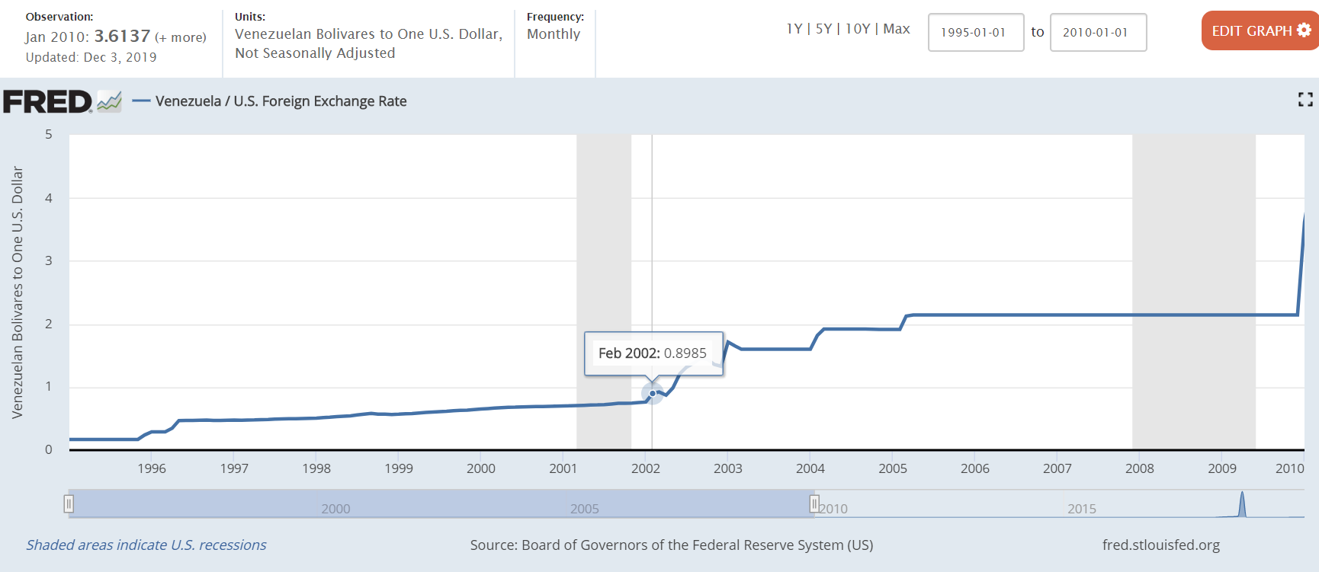
Pegging the Bolivar
To combat massive depreciation of currency and continued capital flight, Chavez pegged the bolivar to the dollar in 2003 at 1600 bolivares to the dollar.
Also established strict capital and price controls to combat capital flight and inflation

Slide 24
Consequences
Slow, but significant, overvaluation of the bolivar as inflation rose due to economic growth
Report in 2008 states that real value of bolivar was around 4200 bolivares to the dollar while peg was set at 2150 bolivares to the dollar
Led to more expensive exports and lack of development of non-oil sectors
Currency controls allowed gov’t to siphon off money, increasing corruption.
Long-term foreign investment lagged due to nationalizations and takeovers of private companies.
Price controls led to decreased profits and stifling of domestic businesses.
Notes:
Due to oil revenue influx

Slide 25
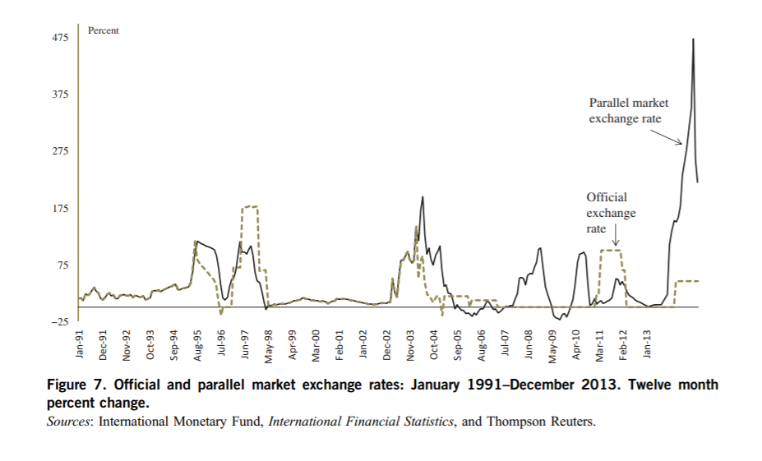
Creation of Parallel Exchange Rate
Also induced creation of parallel exchange rate: rate that currency traded for on black market
Percent Change

Slide 26
2008 Recession
Inflation and capital flight in Venezuela began to accelerate.
The Chavez administration decided against austerity measures and tightened price and exchange controls.
Led to decreased domestic production and increased capital flight--->made Venezuela one of the hardest hit countries by the recession in the late 2010s
Divergence of parallel exchange rate from official exchange rate led to huge price distortions and opportunities for further corruption.
Established tiered exchange rate system in early 2010s with different rates for different goods
Notes:
Talk about different rates for different goods

Slide 27
Connection to Maduro and Current Crisis
When oil prices fell in 2014, Maduro:
Added more tiers to exchange rate system--->opened the door for more economic disorganization and corruption
Tightened price controls to combat inflation--->discouraged domestic production and increased black market trading of goods and currency
Prioritized servicing debt and dropped subsidies on imports--->Venezuela had become dependent on imports for consumer goods--->triggered massive humanitarian crisis
Printed money to cover government debt--->led to massive hyperinflation

Slide 28
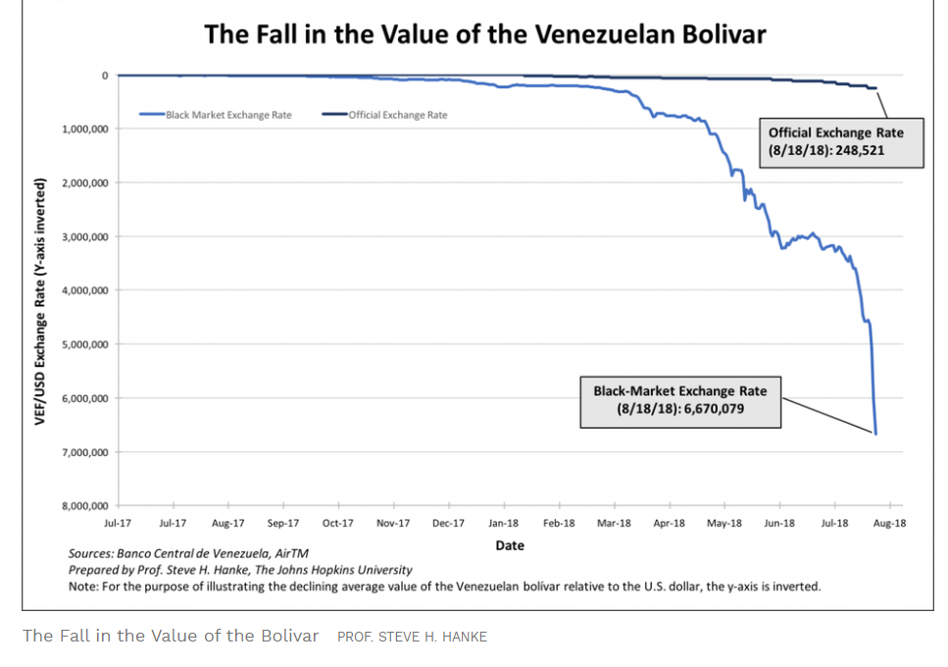
Value of Bolivar

Slide 29
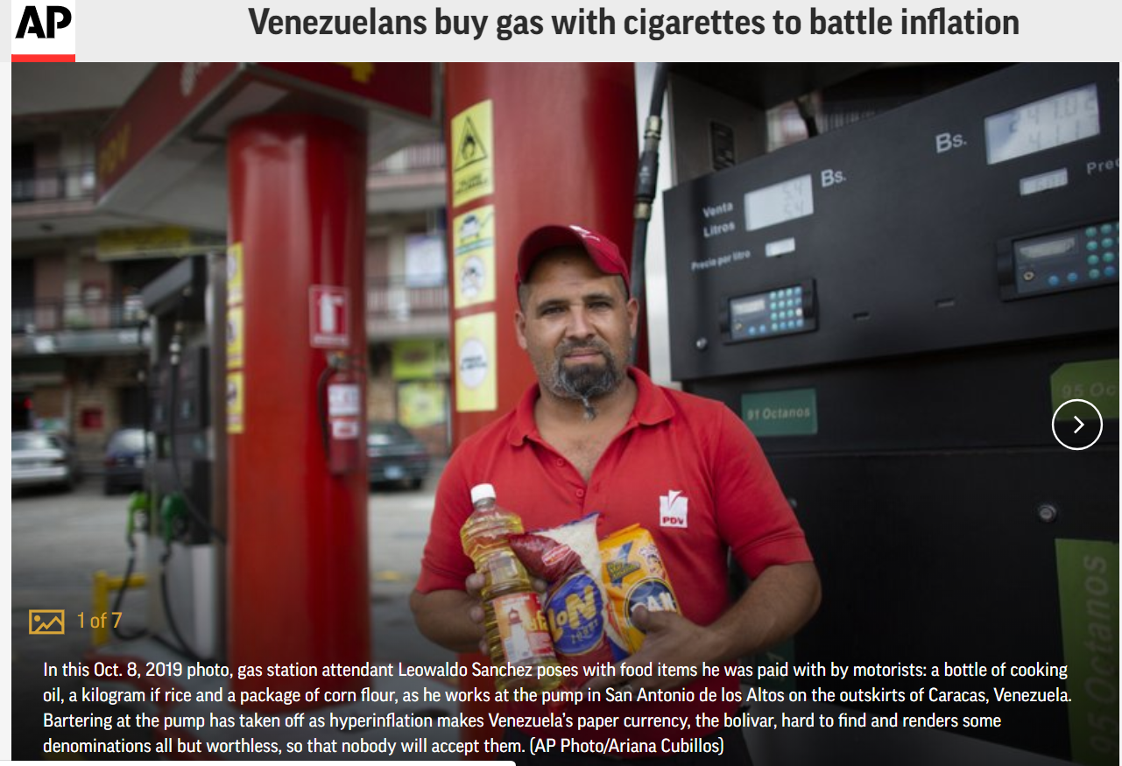
People Pay for Gas With...

Slide 30
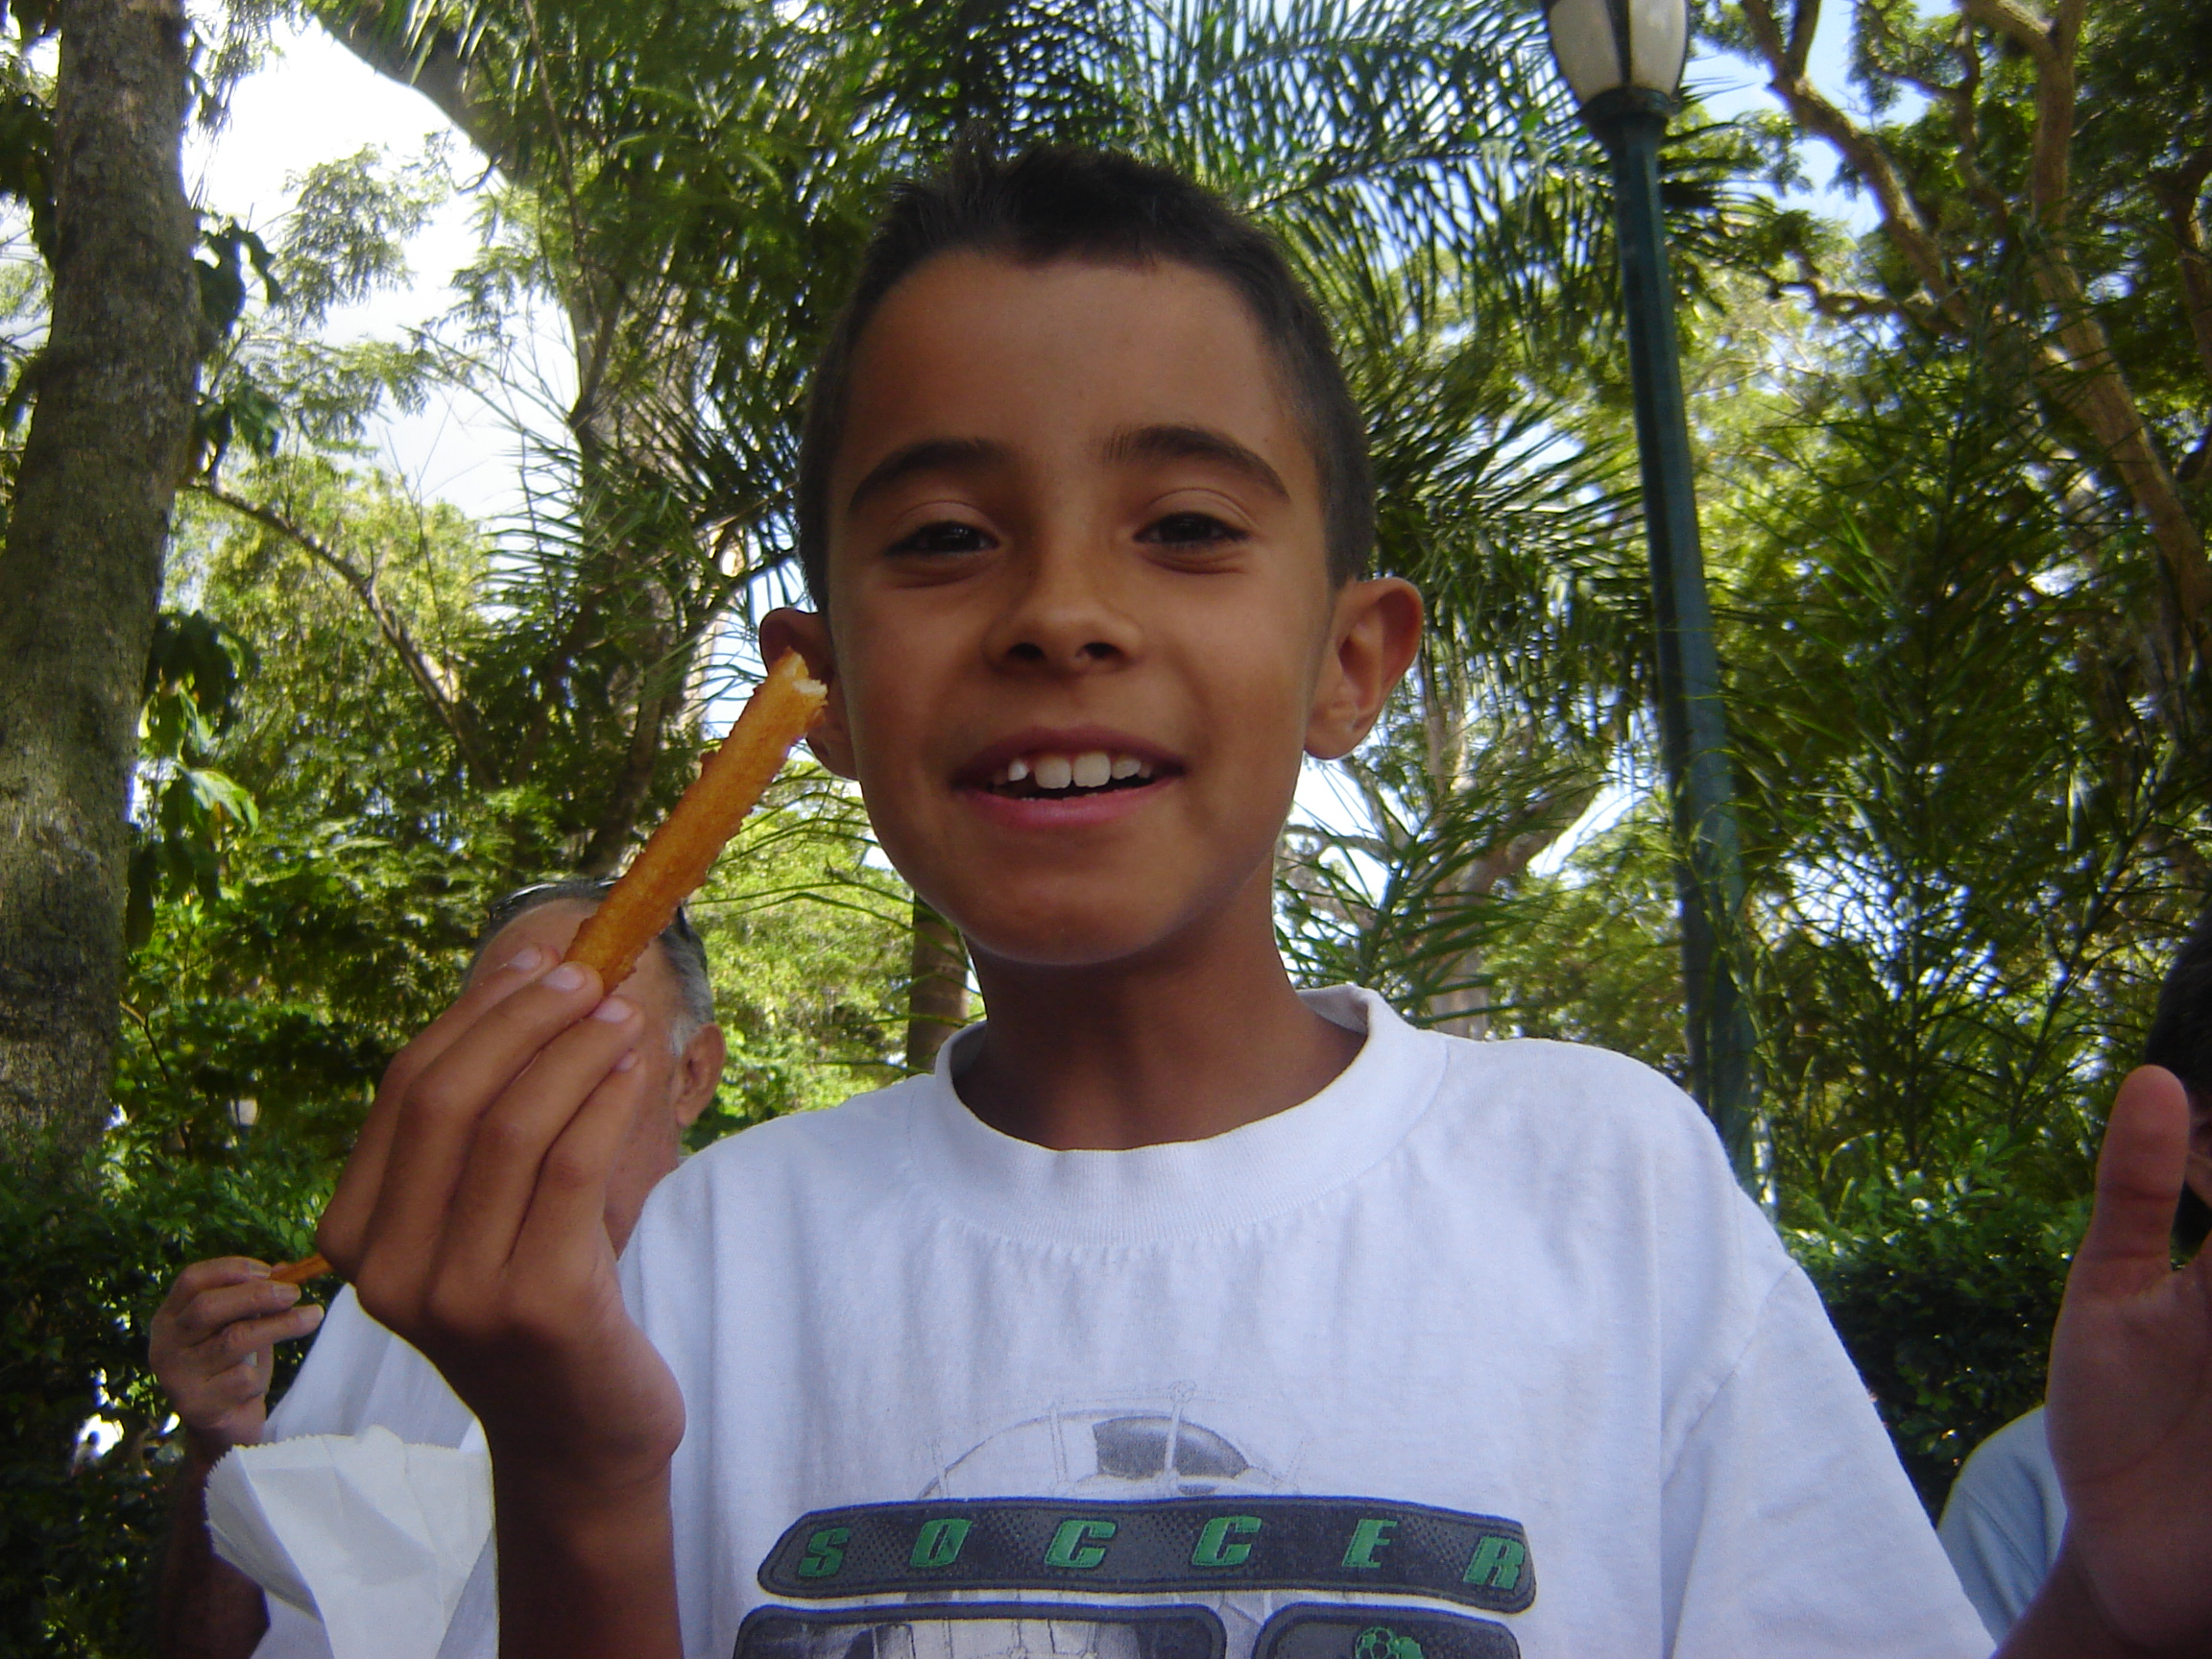
Questions?
La Llovizna National Park, Puerto Ordaz, Venezuela

